Slide 1
Antennas
Chapter 5

Slide 2
Introduction
An antenna is an electrical conductor or system of conductors
  Transmission - radiates electromagnetic energy into space
  Reception - collects electromagnetic energy from space
In two-way communication, the same antenna can be used for transmission and reception

Slide 3
Radiation Patterns
Radiation pattern
  Graphical representation of radiation properties of an antenna
  Depicted as two-dimensional cross section
Beam width (or half-power beam width)
  Measure of directivity of antenna
Reception pattern
  Receiving antenna’s equivalent to radiation pattern

Slide 4
Types of Antennas
Isotropic antenna (idealized)
  Radiates power equally in all directions
Dipole antennas
  Half-wave dipole antenna (or Hertz antenna)
  Quarter-wave vertical antenna (or Marconi antenna)
Parabolic Reflective Antenna

Slide 5
Antenna Gain
Antenna gain
  Power output, in a particular direction, compared to that produced in any direction by a perfect omnidirectional antenna (isotropic antenna)
Effective area
  Related to physical size and shape of antenna

Slide 6
Propagation Modes
Ground-wave propagation
Sky-wave propagation
Line-of-sight propagation

Slide 7
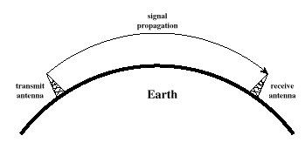
Ground Wave Propagation

Slide 8
Ground Wave Propagation
Follows contour of the earth
Can Propagate considerable distances
Frequencies up to 2 MHz
Example
  AM radio

Slide 9
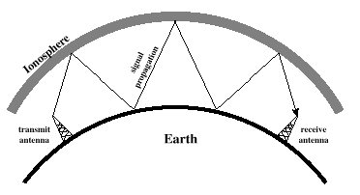
Sky Wave Propagation

Slide 10
Sky Wave Propagation
Signal reflected from ionized layer of atmosphere back down to earth
Signal can travel a number of hops, back and forth between ionosphere and earth’s surface
Reflection effect caused by refraction
Examples
  Amateur radio
  CB radio

Slide 11
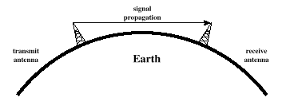
Line-of-Sight Propagation

Slide 12
Line-of-Sight Propagation
Transmitting and receiving antennas must be within line of sight
  Satellite communication – signal above 30 MHz not reflected by ionosphere
  Ground communication – antennas within effective line of site due to refraction
Refraction – bending of microwaves by the atmosphere
  Velocity of electromagnetic wave is a function of the density of the medium
  When wave changes medium, speed changes
  Wave bends at the boundary between mediums

